Slide 1







Document type Declaration
Presentation by
Pranshi Solanki
Tanmay Thakre

Slide 2



what is DTD?
A DTD is a Document Type Declaration.
It defines the structure and the legale elements and attributes of anXML document.

Slide 3


Why Use a DTD?
With a DTD, independent groups of people can agree on a standard DTD for interchanging data.
An application can use a DTD to verify that XML data is valid.
An Internal DTD Declaration
If the DTD is declared inside the XML file, it must be wrapped inside the <!DOCTYPE> definition:

Slide 4
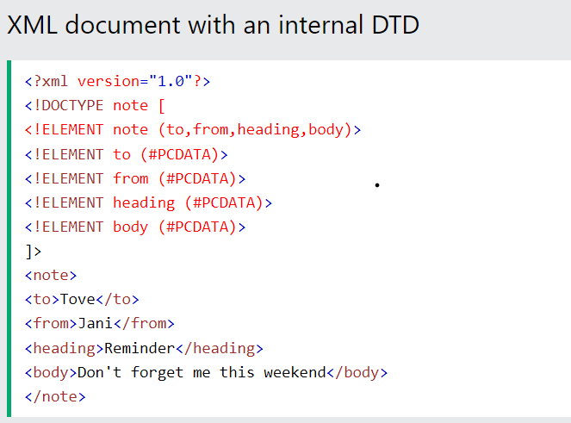
The DTD above is interpreted like this:
!DOCTYPE note defines that the root element of this document is note
!ELEMENT note defines that the note element must contain four elements: "to,from,heading,body"
!ELEMENT to defines the to element to be of type "#PCDATA"
!ELEMENT from defines the from element to be of type "#PCDATA"
!ELEMENT heading defines the heading element to be of type "#PCDATA"
!ELEMENT body defines the body element to be of type "#PCDATA"

Slide 5
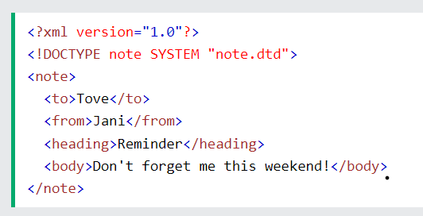
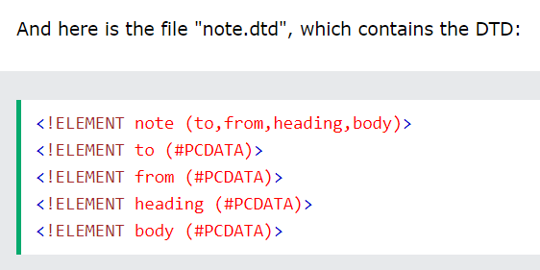
An External DTD Declaration
If the DTD is declared in an external file, the <!DOCTYPE> definition must contain a reference to the DTD file:

Slide 6


The Building Blocks of XML Documents
PCDATA
CDATA
PCDATA is text that WILL be parsed by a parser. The text will be examined by the parser for entities and markup.
CDATA is text that will NOT be parsed by a parser
Elements
Entity
Attributes
Define the structure and content of the XML data.
Represents frequency used strings in the XML documents
Provide additional Information about elements.

Slide 7



DTD Elements
Empty Elements
Element without any content
Element Declaration
specifies the name and content of an element
Child Element
Defines the order and occurence of child elements

Slide 8
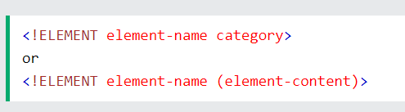
Declaring Element
In a DTD, XML elements are declared with the following syntax:

Slide 9
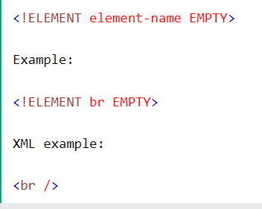
Empty Element
Empty elements are declared with the category keyword EMPTY:

Slide 10
Child Element(sequences)
Elements with one or more children are declared with the name of the children elements inside parentheses:

Slide 11


DTD Attributes
Declaring Attribues
Default Attribute
Enumerated Attribute

Slide 12
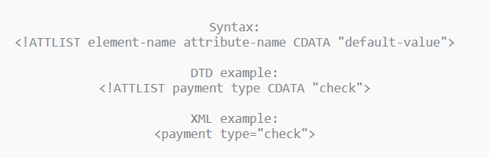
Declaring Attributes
<!ATLIST element_name Attribute_name Attribute_type default_value>
Attribute-type
CDATA
(en1|en2|..)
ID
IDREF
IDREFS
NMTOKEN
NMTOKENS
ENTITY
ENTITIES
NOTATION
xml:
Attribute-default-value:
#DEFAULT
#REQUIERED
#IMPLIED
#FIXED value
“cheque”
cheque

Slide 13
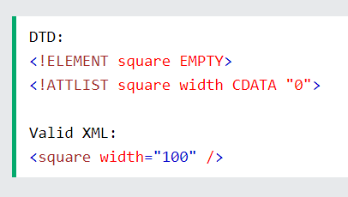
Default Attributes
Specifying a default value for an attribute, assures that the attribute will get a value even if the author of the XML document didn’t include it

Slide 14
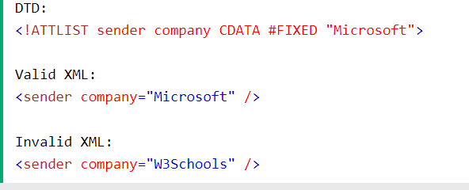
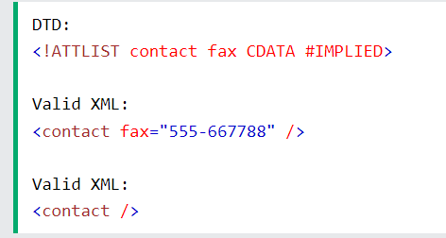
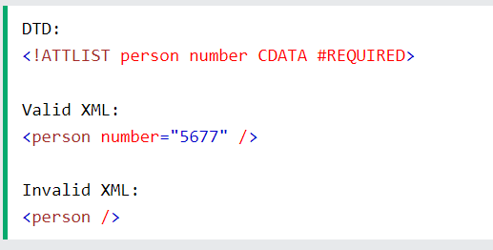
Default Attributes
#FIXED
#IMPLIED
#REQUIERED

Slide 15
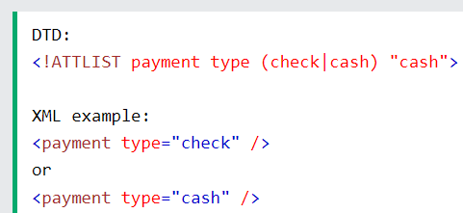
Enumerated Attributes
Use enumerated attribute values when you want the attribute value to be one of a fixed set of legal values
<!ATTLIST element-name attribute-name (en1|en2|..) default-value>

Slide 16



Entities
Internal Entity
External Entity

Slide 17
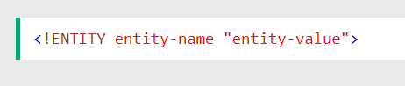
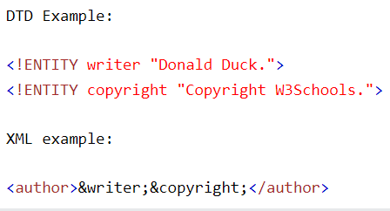
Internal Entity
Internal entities are a mechanism to define replacement values, whenever the entityName is referenced in the XML document, the entityValue is substituted in its place. The XML Parser parsers the substituted entityValue as XML data.

Slide 18
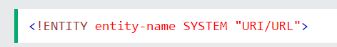
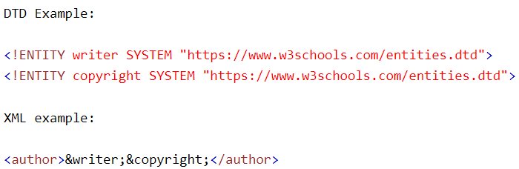
External Entity
XML external entities are a type of custom entity whose definition is located outside of the DTD where they are declared

Slide 19

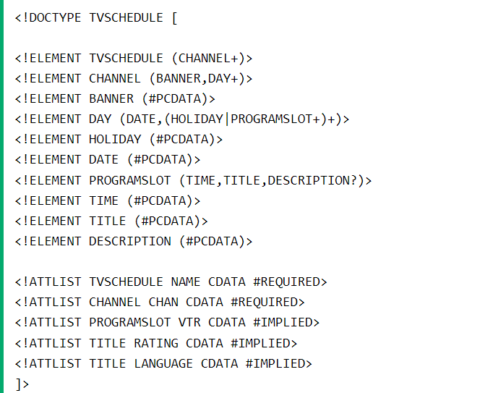

Real life Example (TV SCHEDULE)

Slide 20
Thank You

